Slide 1
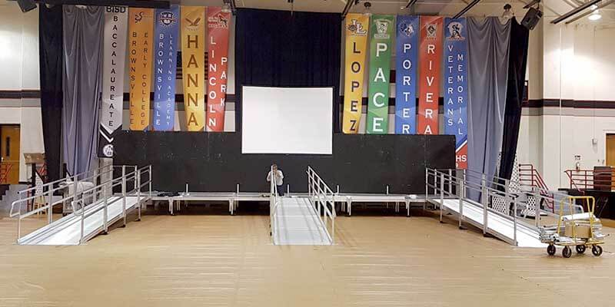
Analysis And Prediction Of
Wheather An Event Venue Has A Ramp
Presented By: Gautam Kumar Jaiswal
Presented To: The Marketing Manager

Slide 2




2. Exploratory Data
Analysis Findings
1. Work Motivation
4. Summary and
Next Steps
Recommendations
3. Predictive Model’s
Findings

Slide 3
Research Motivation
Business Problem
Whether Event Venue already has a wheelchair ramp installed?
Study and Find at least two-thirds of venues predicted to be without a ramp should not have a ramp.
Work Plan
Analyse the relationship within data and important characterstics for result.
Build to predict whether an event venue has a wheelchair ramp.
Assess the prediction of the Venues’s characterstics.

Slide 4
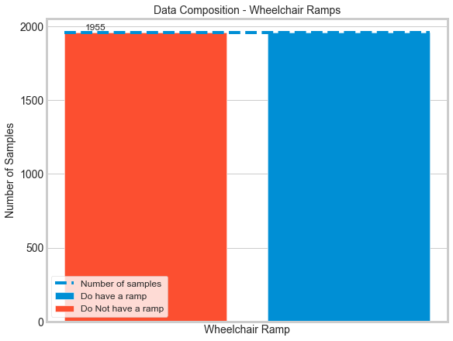
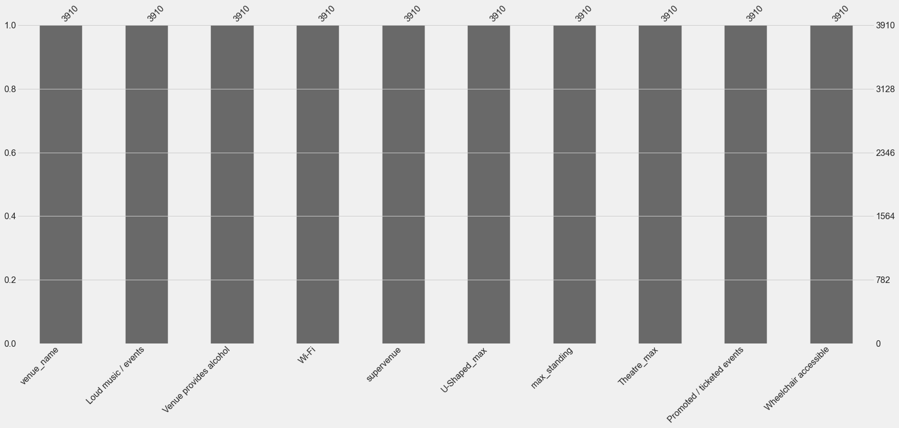
Exploratory Data Analysis Findings

Slide 5
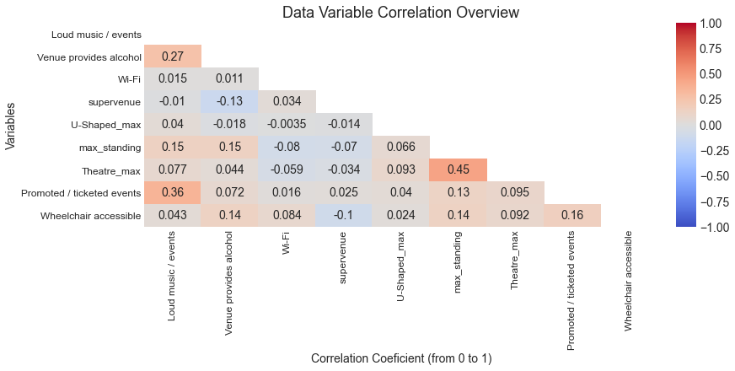
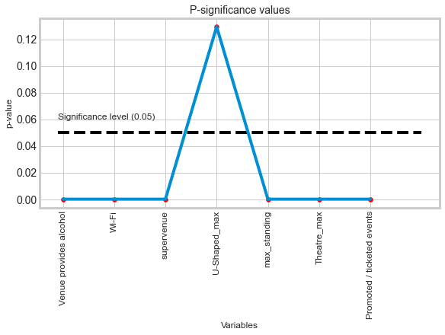
Exploratory Data Analysis Findings

Slide 6
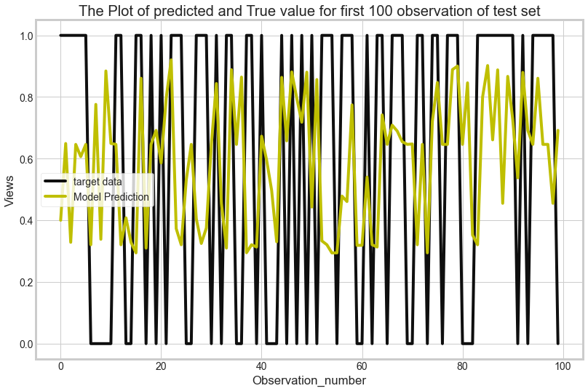
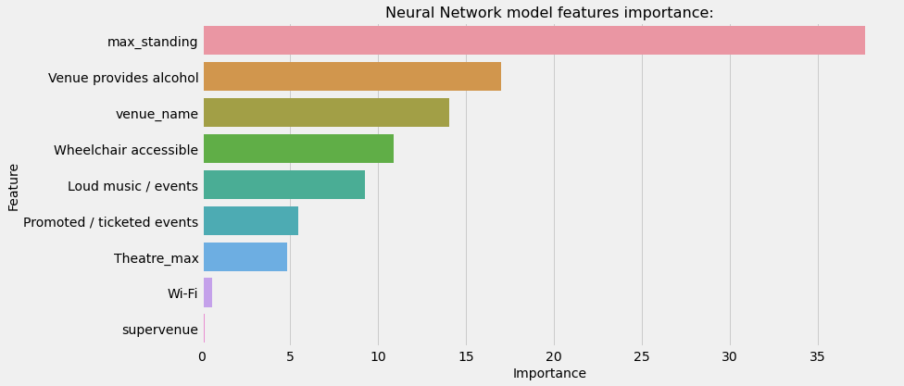
Predictive Model’s Findings

Slide 7
Summary and Future Work
Work Impact
Explored the characterstics of venues that impact the predictive model.
Built a predictive model to know whether an event venue has a wheelchair ramp.
Found that at least two-thirds of venues predicted to be without a ramp should not have a ramp.
Recommendations
Optimise and Improve Accuracy of Predictive model.
Deploy and Host the model.
We can focus on quality of ramp according to the venue location.
In case of continous analysis , I suggest to focus on more characterstics such as date od event, vanue area, maximun wheelchair people.

Slide 8
Thank You For
Your Attention!
Have A Good Day!

